Slide 1




Astronomy 1010 chapter 14
Clayton State University
Slides for Astronomy textbook from OpenStax
https://openstax.org/books/astronomy/

Slide 2
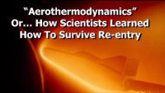
What heats up the meteors and spaceships at reentry?
Is it NOT friction! But what is it?

Slide 3
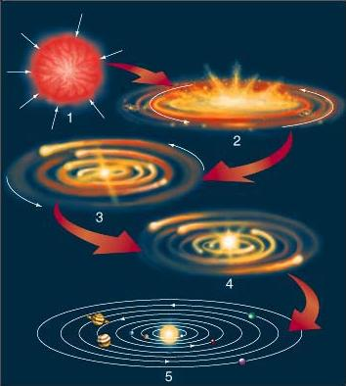
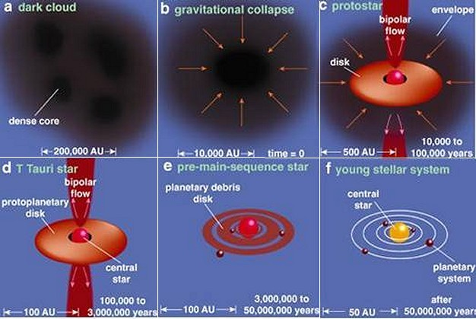
Solar System formation
From a gas cloud
Planets migration

Slide 4
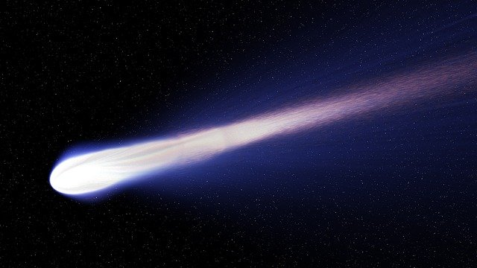
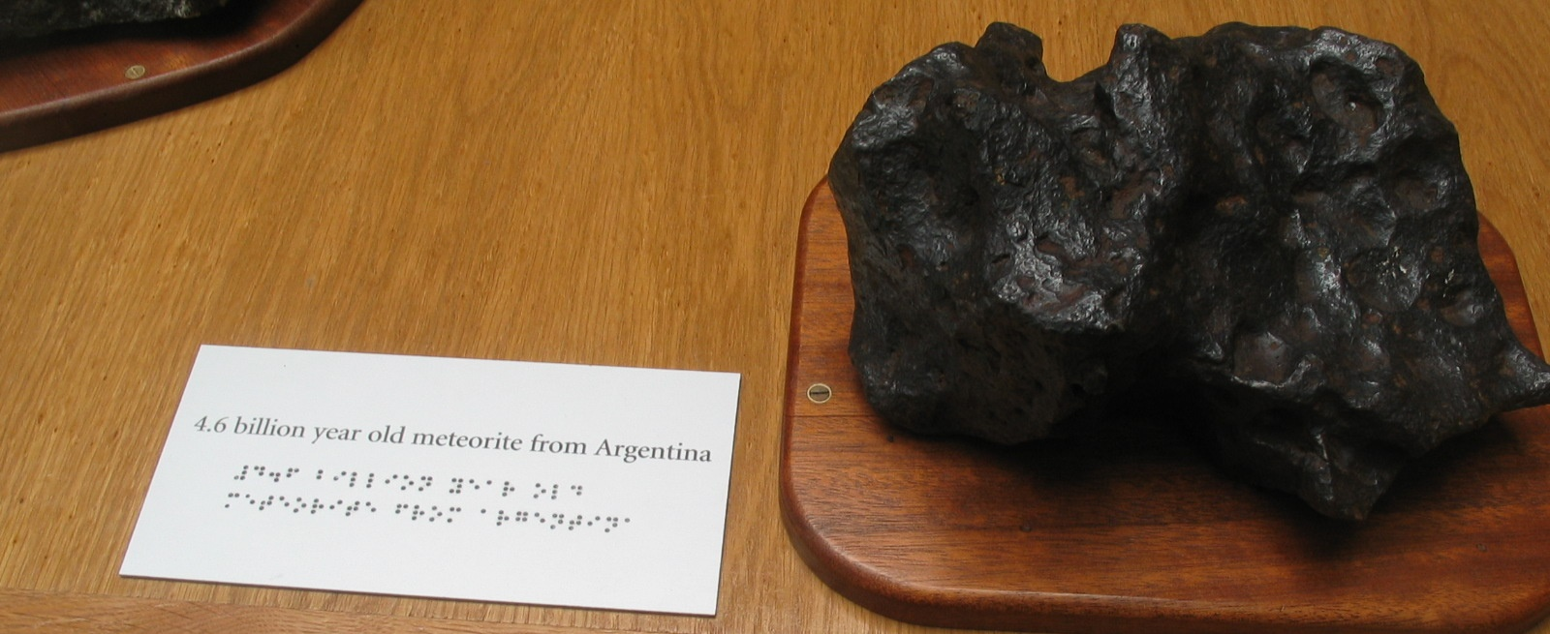
Evidence of early composition
Comets and meteorites

Slide 5
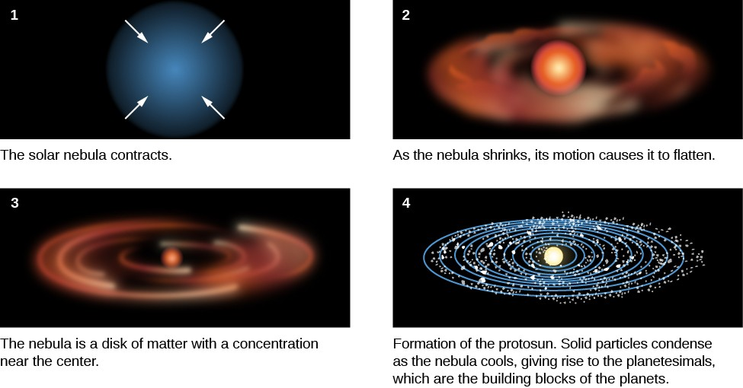
Solar System formation

Slide 6
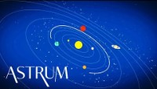
Why planets orbit in the same orbital plane?

Slide 7
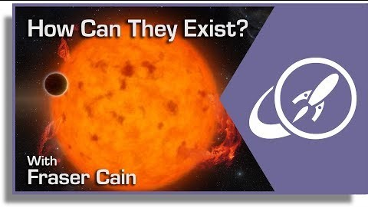
A Planetary Migration
https://www.youtube.com/watch?v=Ln1BHpoPYYM

Slide 8

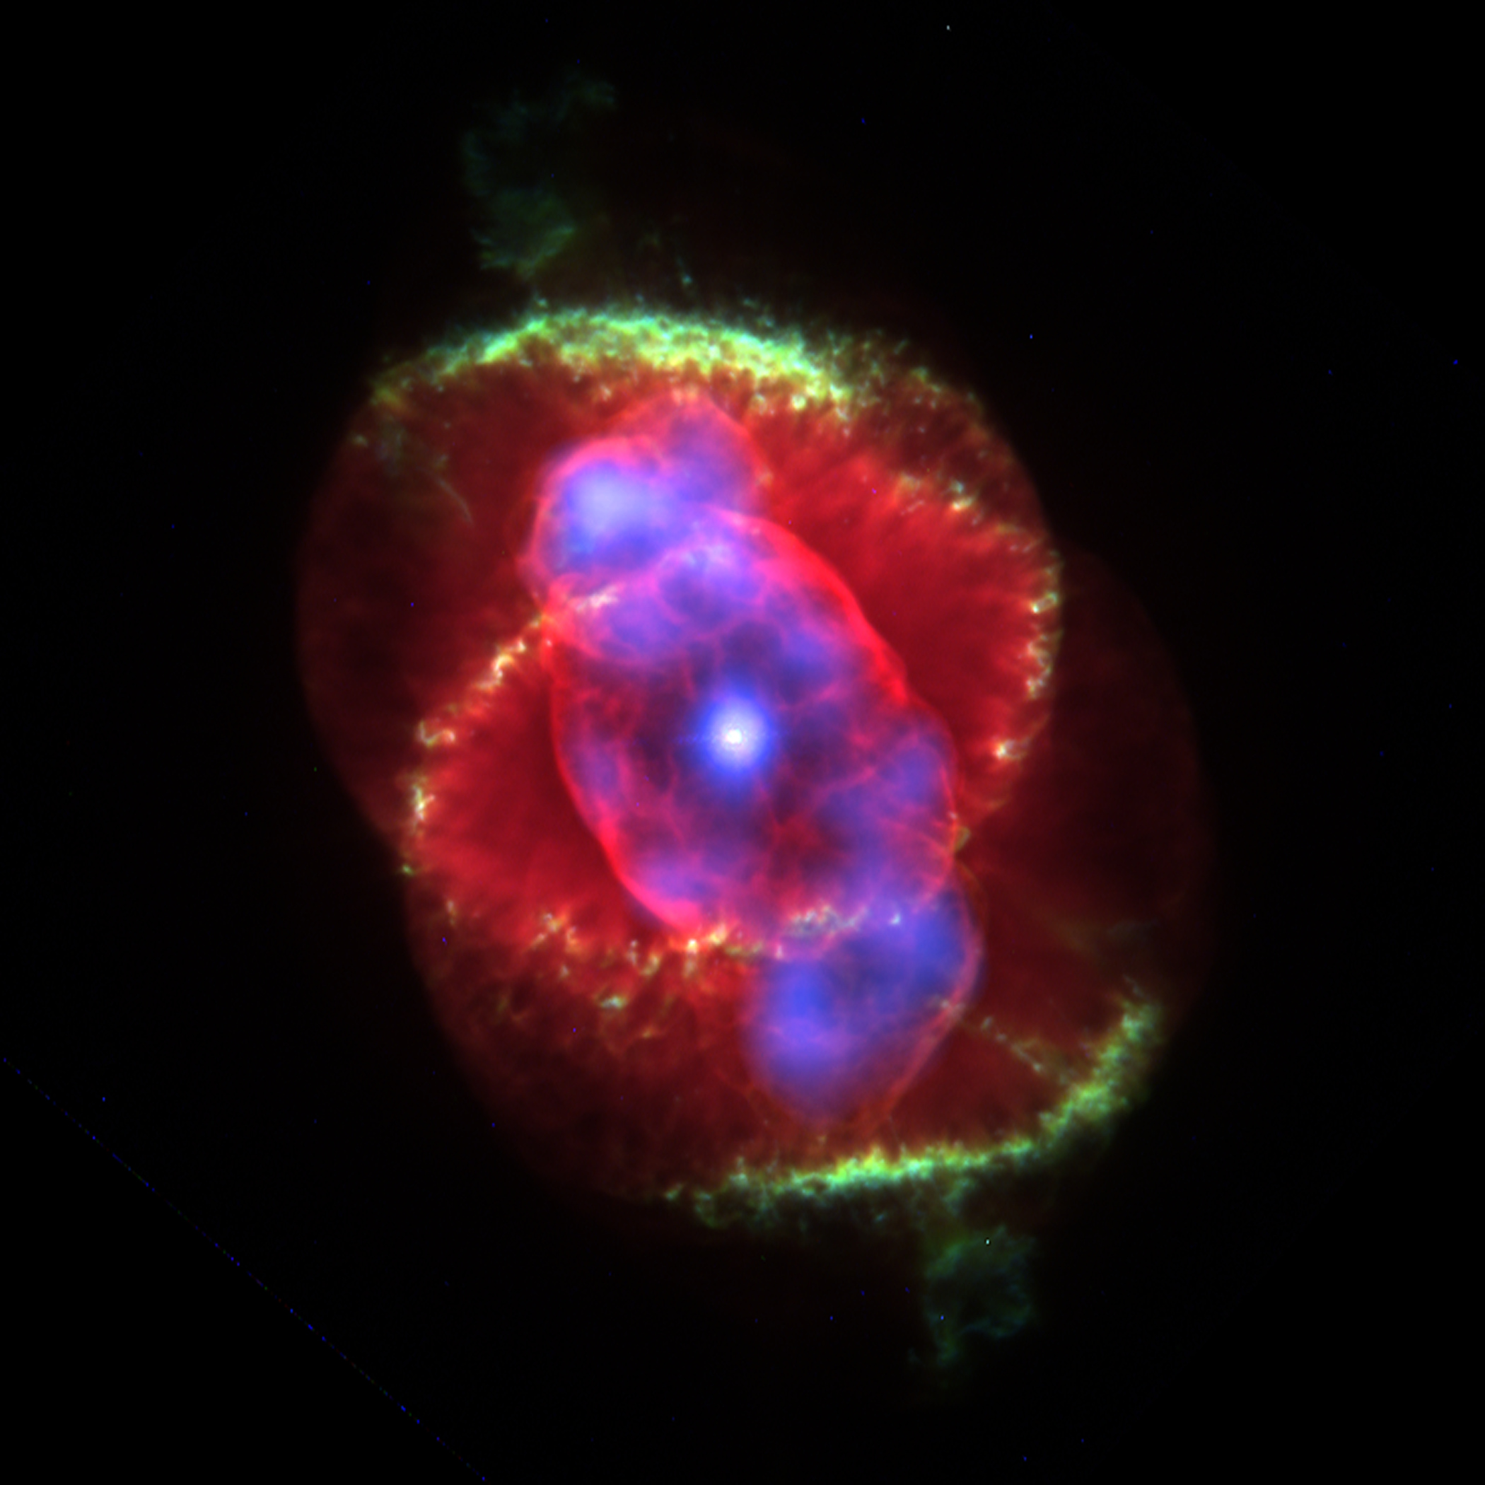
Any questions?
While this was initially called a ‘planetary nebula’, it has nothing to do with planets formation
In fact, it’s a remnant of the dead star!

